Slide 1
Mobile user classification
Machine learning project

Slide 2
Team members
Shaker ibna kamal -144439
Minhaz Uddin ahmed - 144440
Adib ahsan Chowdhury – 144446

Slide 3
introduction
With the advancement of technology, the number of mobile users has grown drastically .
Mobile companies have to deal with their subscribers in a more constructive fashion.
As a result, classification of users has evolved. According to internet, by the end of march, 2013, the number of mobile users in china has reached 1.146 billion.
to ensure appropriate service for the users, different algorithms has been used such as Decision Tree(C4.5,CART,ID3), Bayes Classifiers, Neural Networking etc.

Slide 4
Why it is needed ?
To properly classify users
To ensure users’ satisfaction
befitting distribution of value added services
Ensuring premium facilities for ‘star’ customers
Fraud detection
Reduce advertising cost

Slide 5
algorithms
Decision tree :
Pros: can work with a lot of attributes
Cons: fails to get good accuracy
Bayesian network algorithm:
Pros: works great with small data set
Cons: doesn’t work with huge data set

Slide 6
algorithms (cont.)
Data Selection Model based on Neural Network:
Pros: reduces time consuming
Cons: bad quality to deal with the nonnumeric data and low learning rate.
Fingerprint Classification System Based On A Modified Genetic Algorithm:
Pros: works great for fingerprints
Cons: Not suitable for mobile data

Slide 7
A Modified Mobile User Classification Model
Step 1. Data Partition
Step 2. Generated Rules by Decision Tree
Step 3. Optimize the Rule by Genetic Algorithm
Step 4. Test the Optimized Rule

Slide 8
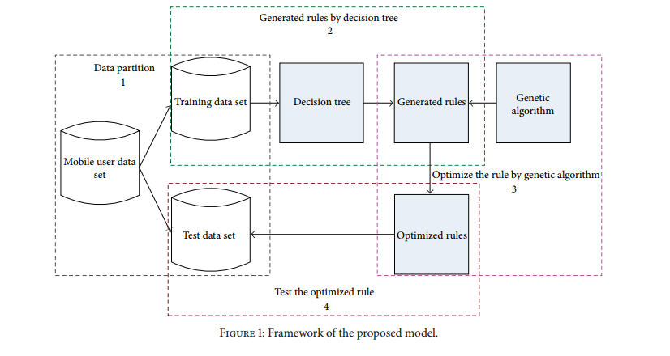
FRAMEWORK OF THE PROPOSED MODEL

Slide 9
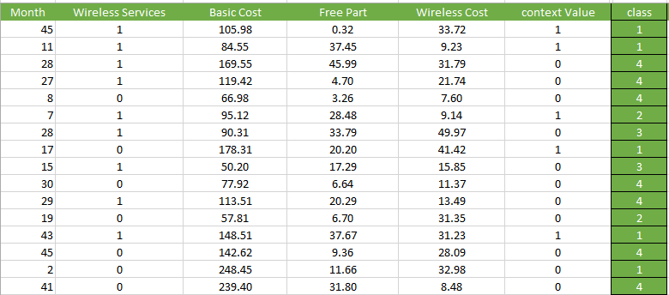
dataset

Slide 10
Generating decision tree
At first, info gain of attributes must be calculated. As we have some attributes with continuous values, we took the average value of minimum & maximum value to find a binary split point of the attribute
Then, the tree is generated based on the values of info gain(id3).

Slide 11
Applying Genetic Algorithms
Each Gene include four elements-
Weight
Operator
Value
Gain ratio

Slide 12
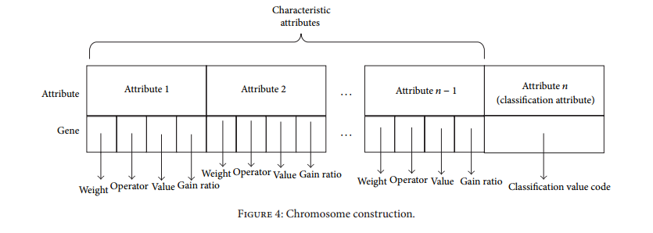
Chromosome construction

Slide 13
Fitness Function For Rule
(1)T_T: it denotes the number of the rule predicting the sample is true and the actual is true;
(2)T_F: it denotes the number of the rule predicting the sample is true and the actual is false;
(3)F_T: it denotes the number of the rule predicting the sample is fault and the actual is true;
(4)F_F: it denotes the number of the rule predicting the sample is fault and the actual is fault.

Slide 14
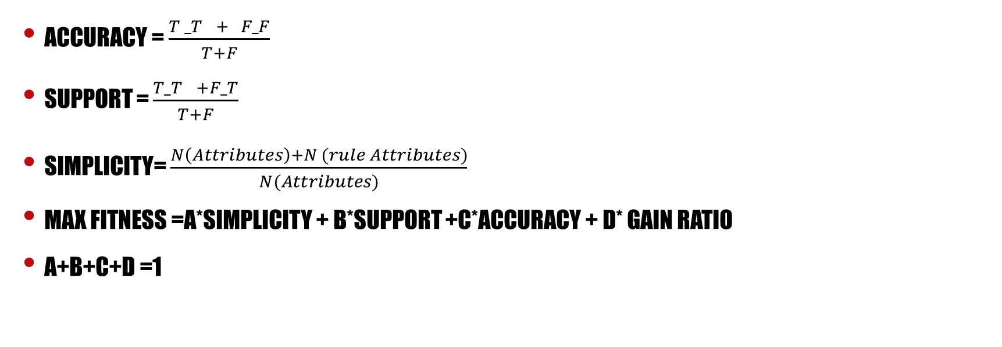
Fitness Function For Rule(cont.)
Accuracy = $\frac{{T _T}_{}+ F_F}{T+F}$
Support = $\frac{{T_T}_{}+F_T}{T+F}$
Simplicity= $\frac{N\left(Attributes\right)+N (rule Attributes)}{N(Attributes)}$
Max Fitness =a*simplicity + b*support +c*accuracy + d* gain ratio
a+b+c+d =1

Slide 15
Crossover & Mutation
Two Point Crossover is used here
Weight Mutation
Operator Mutation
Value Mutation

Slide 16
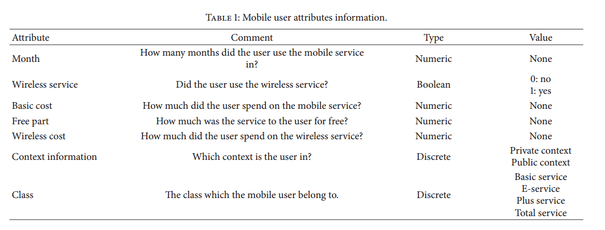
Attributes info

Slide 17
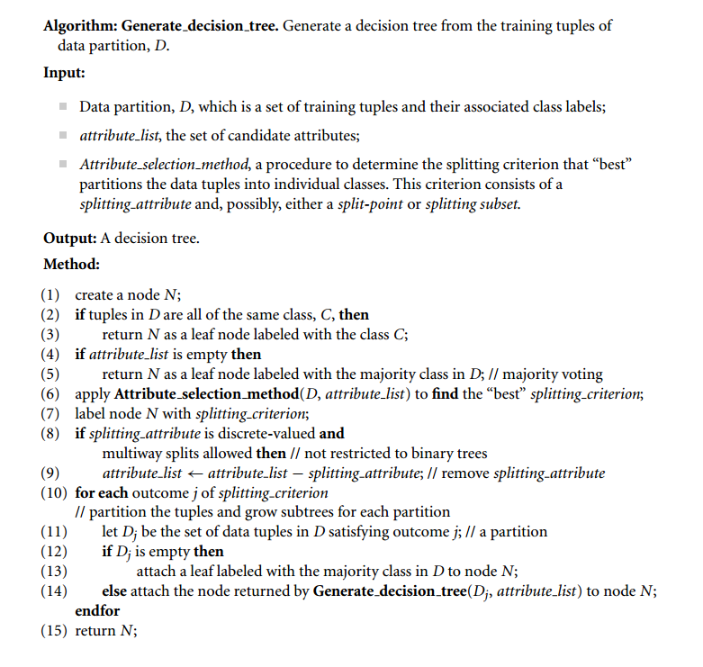
Decision tree algorithms

Slide 18
references
A Modified Decision Tree Algorithm Based on Genetic Algorithm for Mobile User Classification Problem -Dong-sheng Liu and Shu-jiang Fan
Data Mining Concepts & techniques – j Han
Machine learning – tom m mitchell

